Slide 1
Data Structure -ADT
Prepared By Mr . Venkatesh H

Slide 2
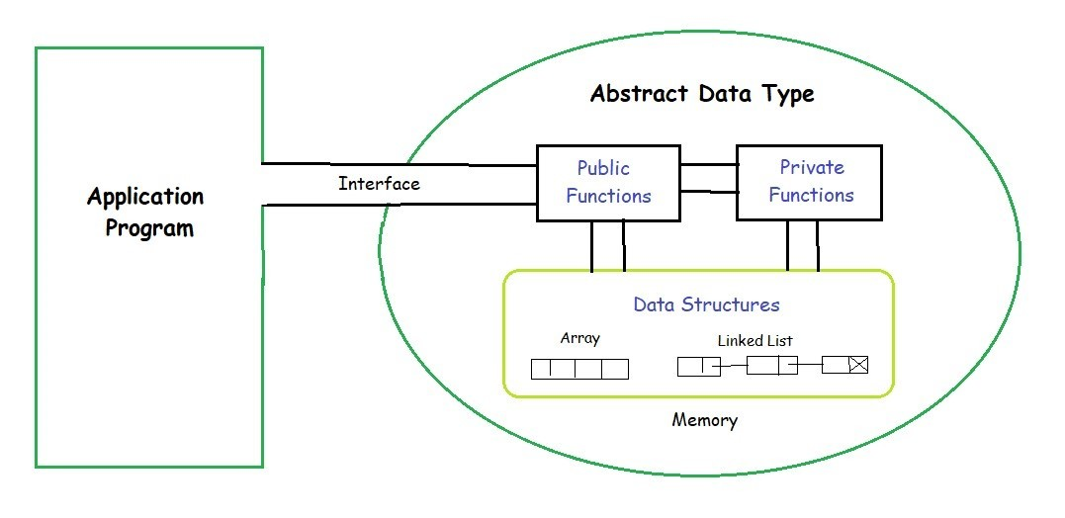
Abstract Data Types
Abstract Data type (ADT) is a type (or class) for objects whose behaviour is defined by a set of value and a set of operations.
The definition of ADT only mentions what operations are to be performed but not how these operations will be implemented. It does not specify how data will be organized in memory and what algorithms will be used for implementing the operations. It is called “abstract” because it gives an implementation-independent view. The process of providing only the essentials and hiding the details is known as abstraction.

Slide 3
Continue…
The user of data type does not need to know how that data type is implemented, for example, we have been using Primitive values like int, float, char data types only with the knowledge that these data type can operate and be performed on without any idea of how they are implemented.
So a user only needs to know what a data type can do, but not how it will be implemented. Think of ADT as a black box which hides the inner structure and design of the data type. Now we’ll define three ADTs namely List ADT, Stack ADT, Queue ADT.

Slide 4
What is Data type?
Two important things about data types
Defines a certain domain of values
Defines operations allowed on those values.
Example:
Int type
Takes only integer values
Operations: addition, subtraction, Multiplication, bitwise operations etc.
Float type
Takes only floating point values
Operations: addition, subtraction, Multiplication, division etc.. (bitwise and % operations are not allowed)

Slide 5
User Defined Data types
In contrast to primitive data types, there is a concept of user defined data types.
The operations and values of user defined data types are not specified in the language itself but is specified by the user.
Example : Structure, Union, enumeration.
By using structures, we are defining our own type by combining other data types.
struct point {
int a;
int b;
};

Slide 6
Abstract Data Types - ADT
ADTs are like user defined data types which defines operations on values using functions without specifying what is there inside the function and how the operations are performed.
Example : Stack ADT
A Stack consist of elements of same type arranged in sequential order.
Operations:
Initialize()- initializing it to be empty.
Push()- Insert an element into the Stack
Pop()- Delete an element from the Stack
isEmpty()- Checks if stack is empty
isFull()- Checks if stack if Full

Slide 7
Continue…
Think of ADT as a black box which hides the inner structure and design of the data type from the user.
There are multiple ways to implement an ADT.
Example: A stack can be implemented using arrays and linked list.

Slide 8
Why ADT?
The program which uses data structure is called a client program.
It has access to the ADT ie. Interface.
The program which implements the data structure is know as implementation.
Advantages
- Let say, if some one wants to use the stack in the program, then he can simply use push and pop operations without its implementation.

Slide 9
Continue…
ADT provides Abstraction
Hiding details from the user.. Only use it…

